Slide 1


Economy: 6 pillars + theory + current affairs
1.Banking, Fin, Insur.
6.HRD
2.Budget
3.BoP
4.Sectors
5.Infra
V1:c3,4
V1:c2,3, 6,9,11(GST),13
V1c:5
V1c:7,11(Trade)
V1c:10
v1c:12, 14; Budget^Rail

Slide 2
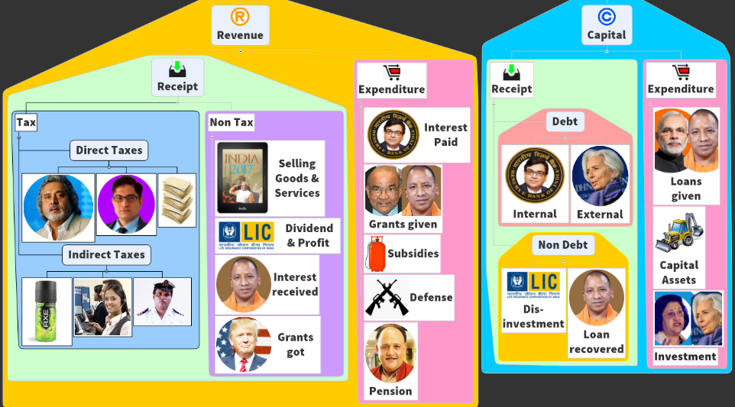


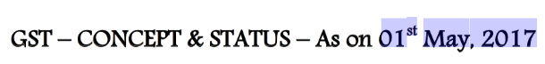
Budget ► Revenue ► Receipt ► Tax
+ Rates from TheHindu on 20th May.
Then new updates- self edit, PPT on Mrunal.org/Powerpoint
Goods and Services TAX

Slide 3


Goods and services Tax (GST)
Cascading Effect, ITC, MODVAT, CENVAT, VAT
Polity Angle, GST council?
Benefits
Compensation
Cess
Classification
& Slabs
Challenges:
E-way bill, “Compliance Cost”?
GST: IGST, CGST, SGST, UTGST
GSTIN Registration?

Slide 4
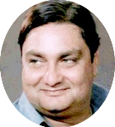
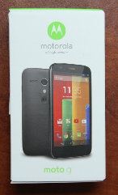

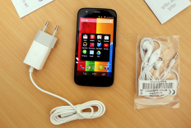
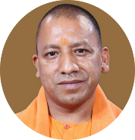

10% Tax @ Sale of goods on every stage
Rs.10,000
Rs.10,000/-
Rs.01,000/-
Rs.00,500
+500 Value & profit added
Rs.11,500
Rs.1,000
Rs.1150
= 12,650
1000+100+50
10% Sales Tax
10% Sales Tax
Final consumer

Slide 5


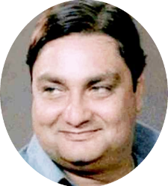


Single Point Indirect Tax: Cascading Effect
Wholesaler
Retailer
Final Customer
Tax on Tax
Let’s sell without bill!
Black money▲
We can bribe him!
Black money ▲
Cheap ☺
But consumer protection, warranty ☹
Inspector raj
Notes:
Cascading effect: Tax on tax
Sell without bill = No tax liability.
Bribe the inspectors
Black money ▲ [because tax not paid]
Fiscal deficit ▲ [due to revenue shortfall]

Slide 6
10% tax only on the “value” added @ intermediate stage.. 10% tax on “sale” @Final customer stage.
0
Rs.10,000
Rs.10,000/-
Rs.01,000/-
Rs.00,500
+500 Value & profit added
Rs.10,500
Rs.1,000
Rs.1050
11,550
1000+__+50
10% VAT
10% VAT
Final consumer
Input credit comes from his tax

Slide 7

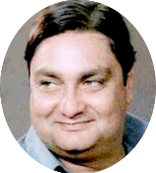


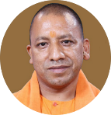
Dealer’s VAT / GST liability to Govt.= Tax received on Output minus Tax paid for Inputs
Rs.10,000
+500
Rs.0
Rs.10,000
Player:
Jetha
Mru
Tax received on output
1000
1,050
- Tax paid on input
1,000
50
Vinay
Govt receives
NA
0
1,000
NA
borne
invoice
invoice
invoice
invoice

Slide 8
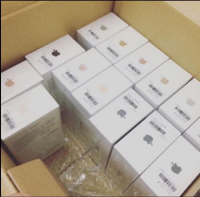





Input tax credit [input minus output]
Paytm wallet: mobile #
VAT: “TIN Account #”
GST: “GST-IN Account #”
Input Credit
Jan’18
Feb’18
Tax Paid on input
10,000
0
Tax Received on Output
4000
5,000
+6000
Rest Stock unsold
1000 remain
Dealer gets credit on taxes already paid on inputs.
And later, these input credits can be used to offset TAX liabilities
But invoice is must, Tax collection ▲, inspector raj ▼, “self-policing”
No new stock
Rest Stock unsold
Notes:
Tax identification number

Slide 9

But How did we reach till here!?
CENVAT
MODVAT
VAT
GST

Slide 10
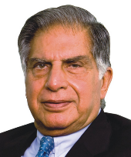


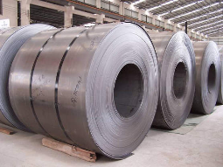
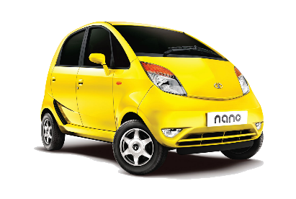
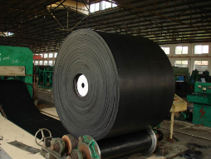

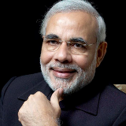
Central Excise applies on “Manufacturing”
50s French implemented input credit on “Excise” first.
70s: LK Jha Committee -> India
MODVAT: Modified Value Added Tax regime
cascading
cascading
Input Credit
Excise
Excise
cascading
Excise
Excise
Excise
Why excise cascading is bad?
End user: expensive car [Statutory incidence-> economic incidence]
Tata would try to mfg. everything in-house to avoid cascading= "Ancillarisation"▼ -> MSME ▼
MODVAT provides input credit on excise paid for raw material and components (1986)

Slide 11





CENVAT: Modified Central Value Added Tax regime
cascading
Service tax: designer, Consultant, Call center
Input Credit
MODVAT
Excise
cascading
Excise
CENVAT provides input credit on both excise and service taxes paid for manufacturing

Slide 12
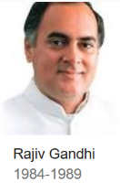
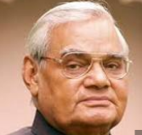
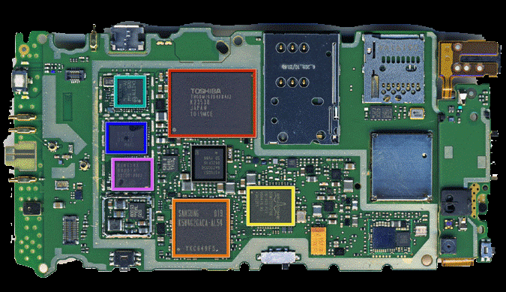
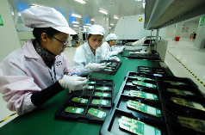
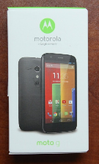


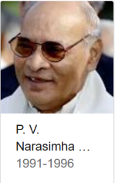

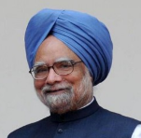
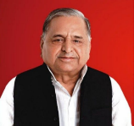
Excise
Central Excise Act ‘44
MODVAT (LK Jha)
1986
Sales tax
CASCADING
CENVAT
2000
CASCADING
CASCADING
Manufacturing
Excise Duty
Service tax
Finance Act ’94
(Raja Chelliah)
Sales Tax
State VAT (2005-08)
GST: 2017
Final consumer
Notes:
44
Central Excise Act
86
MODVAT: LK Jha
94
Finance Act-> Service Tax (Raja Cheliah)
2000
CENVAT
2005
State VAT
2017
GST

Slide 13
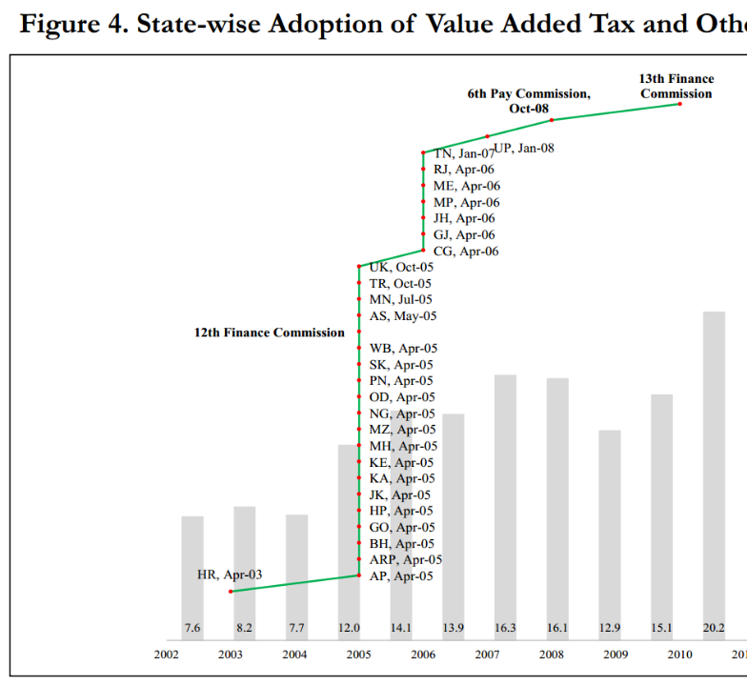

Slide 14
Goods and services Tax (GST)
Cascading Effect, ITC, MODVAT, CENVAT, VAT
Polity Angle, GST council?
Benefits
Compensation
Cess
Classification
& Slabs
Challenges:
E-way bill, “Compliance Cost”?
GST: IGST, CGST, SGST, UTGST
GSTIN Registration?

Slide 15
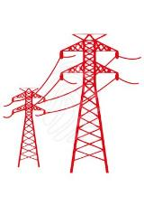

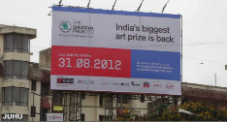






If we’ve CENVAT and State-VAT then why GST?
Service tax
SBC, KKC
Advertisement
Hoarding
Electricity
Cascading Effect
Continues
Fuels
CST
Even no union credit for cess
No “StateVAT” input credit

Slide 16


Cess, Surcharge
Cess, Surcharge
CGST
SGST
Central GST
Mfg-Excise, services
State GST
VAT, purchase tax,
Advertisement, entertainment tax
Cascading Effect
Final consumer
Notes:
2004: Kelkar Fiscal consolidation Task force recommends GST.
2008 Budget: planned to launch from 2010
2009: Empowered Committee of state finance ministers

Slide 17

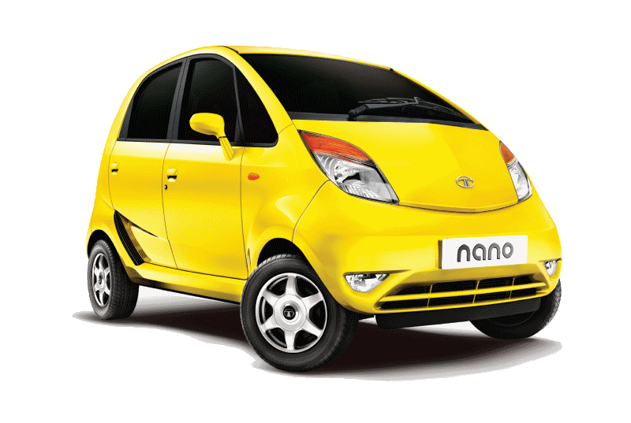

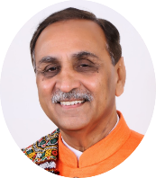
Mfg & Trade within state
Union EXCISE
CGST
State VAT
BEFORE
AFTER
SGST

Slide 18
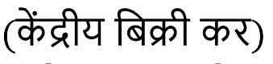
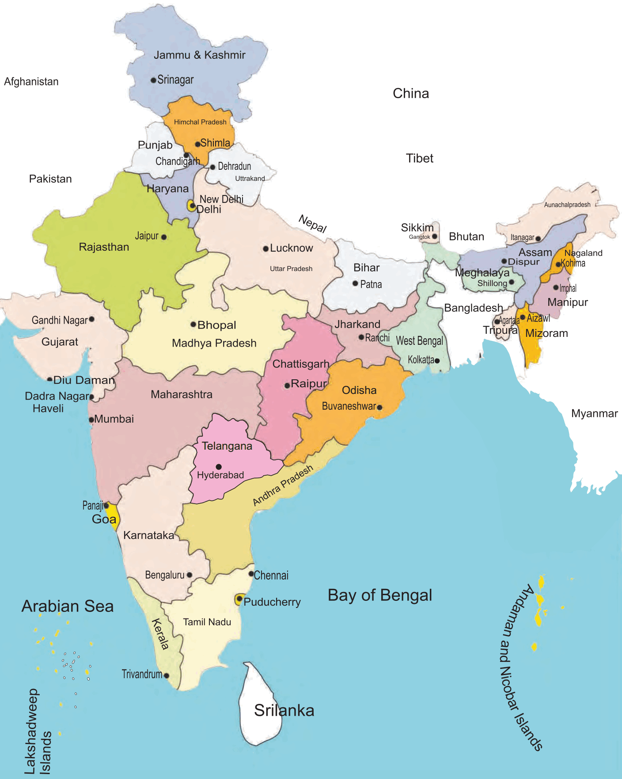
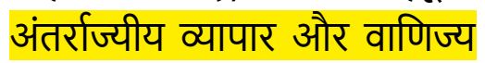
BEFORE: Inter-State Trade
Central Sales Tax (CST)
Union EXCISE
ASSIGNED TO EXPORTER STATE
Destination
State VAT
Inter-state trade
State VAT

Slide 19
After GST: Inter-State Trade
CGST
Integrated GST (IGST)
=CGST+ (destination) SGST
Assigned
Assigned
Inter-state trade
Exporter State
SGST
Destination
SGST

Slide 20
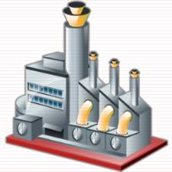
Integrated-GST is not a “TAX” But CGST+SGST
CGST (12%)
CGST
IGST: 30%
SGST
Exporter State
SGST (14%)
Destination
SGST (18%)
1 lakh car
IGST = 30,000

Slide 21
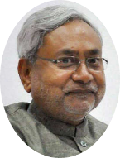


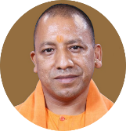
GST : “Input Credit” on inter state trade…
Within State Sales= then also SGST credit accumulated
Raw Material
Input credit
“NEFT” like settlement
Guj vs UP transfer
CGST
SGST
20,000
20,000
8,000
2,000
Demand
12,000
Demand
18,000
1 lakh car
IGST = 30,000

Slide 22
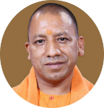


If not understood then…
Union Government will levy Integrated GST (IGST)
During interstate trade.
CGST
SGST
SGST assigned to destination state
SGST credit for paying to State Government(s) (not union)
CGST assigned to Union
CGST input credit used for payment of CGST to union (not state)
Dealer's liability: Taxes collected on output MINUS taxes paid on input.
Dealer will get input credit on taxes already paid.
Two input tax credit (ITC) streams can’t be cross utilized.
Notes:
IGST made up of __ + __?
IGST will be levied by Union Government
CGST transferred to Union
SGST Input credit transferred from “exporter state” to “Importing state” (destination state.)
CGST input credit used for payment of CGST to union (not state)
SGST credit for paying to State Government (not union)
Two input tax credit (ITC) streams can’t be cross utilized.
Dealer’s liability: Output – input.
Warehousing = no tax dodging benefit anymore.

Slide 23


EVEN CENVAT & VAT input credit couldn’t offset each other!
Service tax
CENVAT credit
StateVAT credit
Excise
Because 7th Schedule
No “Concurrent” powers on taxation
VAT

Slide 24
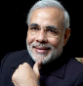

What about union territories!?
CGST
SGST
UTGST
WITHOUT LEGI.
Chandi2Delhi
CGST
SGST
Delhi2Chandi
CGST
UTGST
Mumbai2Diu
CGST
UTGST
TN2Pudu
CGST
SGST
Mfg= EXCISE CGST, irrespective of location.
So, state, UT, CGST will be applicable.

Slide 25
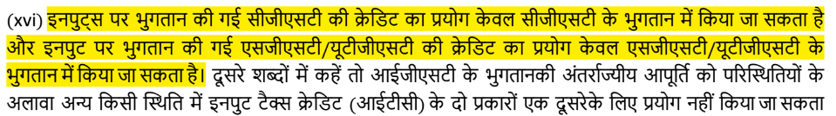
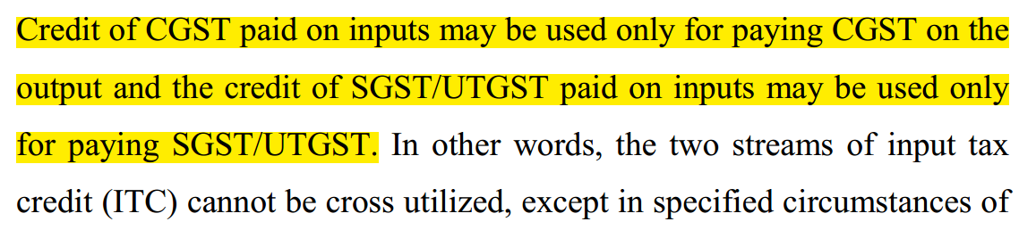


If not understood then…
CGST
UTGST
SGST

Slide 26
Goods and services Tax (GST)
Cascading Effect, ITC, MODVAT, CENVAT, VAT
Polity Angle, GST council?
Benefits
Compensation
Cess
Classification
& Slabs
Challenges:
E-way bill, “Compliance Cost”?
GST: IGST, CGST, SGST, UTGST
GSTIN Registration?

Slide 27
Amendment Timeline
GST
2007: Budget planned to start GST from 2010.
Must amendment 7th Schedule [union and state taxes]
2011: 115th Amendment 2011 [Lapsed in LS]
2013: GSTN private ltd.
2014: 122nd Amendment 2014 in LS
2015: both houses passed
2016, Aug: some amendment so again passed

Slide 28
How to pass the bill?
122nd amend Bill
GST: Changes federal financial relations, hence ‘special majority’ in each house:
>50% of total membership <even if vacant, absent>
2/3rd majority of present & voting.
(+) At least 50% state assemblies (15) have to ‘ratify’ with simple majority. [Assam first, Odisha last].
2016, sept: President signed.
122nd Amendment “bill” -> 101st Amendment ACT
2016, Sept. GST council notified, Project Saksham launched.
2016, Nov: GST migration started
GST Implement from 1/__/201_. [you type the date when it’s done ☺]
Assam
Bihar
Jharkhand
Chhattisgarh
Himachal Pradesh
Gujarat
Madhya Pradesh
Delhi
Nagaland
Maharashtra
Haryana
Sikkim
Mizoram
Telangana
Goa
Odisha

Slide 29
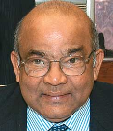
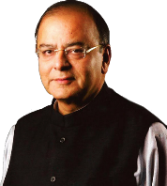


Tax sharing
IGST on inter-state Trade
Union----State
FC will decide how much of the union’s tax (CGST) to share with States.
GST council will decide mechanism.

Slide 30
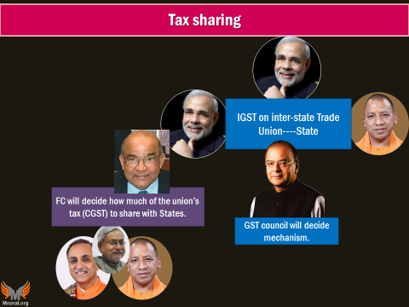
Constitution, after 101st Amendment Act 2016
246-A
269-A
States given power to tax goods and services [earlier only union could]
But only union to tax inter-state commerce of goods and services
Union IGST, parliament to legislate.
270
CGST (union portion OF INDIRECT TAXES) will be distributed between Union and states….as per Finance commission
Money distribution as per GST council recommendations.
279-A
GST council by President

Slide 31
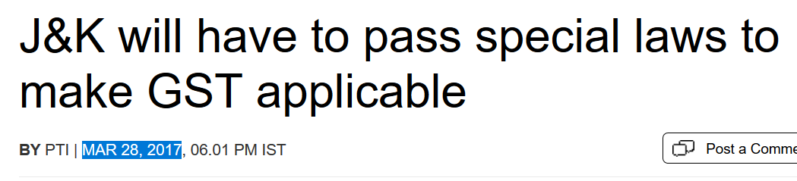
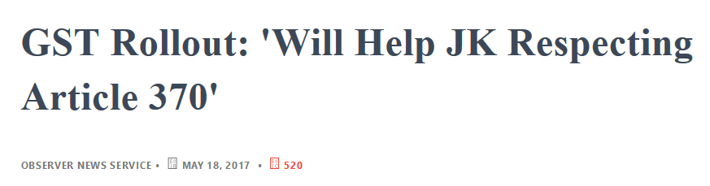
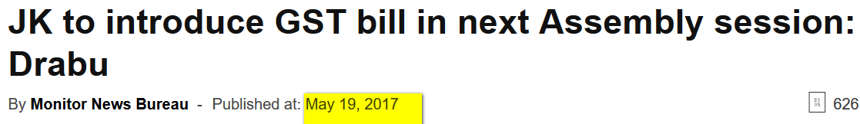
Finance Act 1994: Service tax.
but not applicable to J&K.
246-A
269-A
States given power to tax goods and services
But only union to tax inter-state commerce of goods and services
Union IGST, parliament to legislate.
270
CGST (union portion OF INDIRECT TAXES) will be distributed between Union and states….as per Finance commission
Money distribution as per GST council recommendations.
279-A
GST council by President
Says Jaitley in May 2017
Notes:
http://economictimes.indiatimes.com/news/politics-and-nation/jk-will-have-to-pass-special-laws-to-make-gst-applicable/articleshow/57875063.cms

Slide 32

Article 279-A: President will setup GST council
Non-voting bureaucrats
Revenue Secretary: ex-officio Secretary of Council
CBEC Chairman: Permanent invitee
Finance Minister
State Min. for
Finance
Taxation
Other
Union M.of State
Finance/ Revenue
union
Voting Power
1/3rd
Quorum: 50% of total membership
States voting Power: 2/3rd
3/4th majority for decision = union + min. 20 states must agree on anything.
Notes:
3/4th majority of Present and voting
+ addl. Secretary but not important.

Slide 33
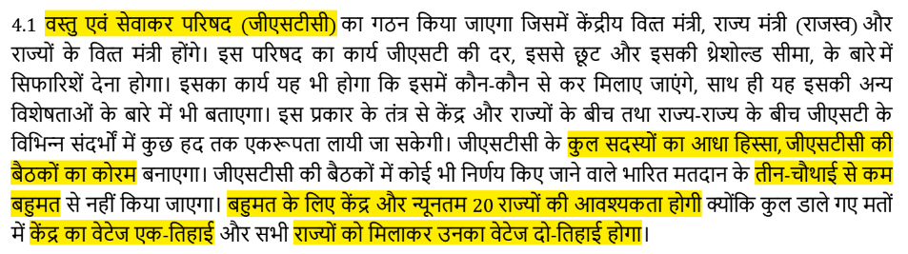
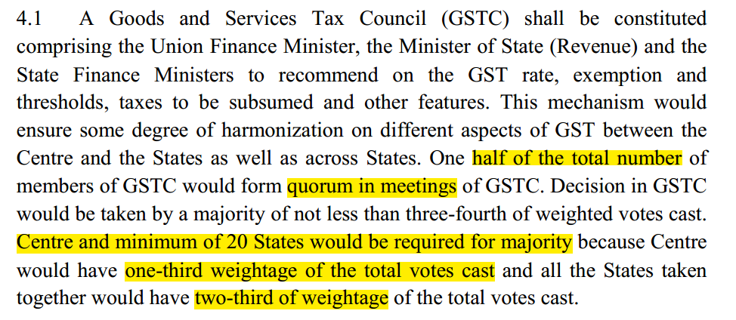

GSM2: Write structure functions of GSTC

Slide 34

GSM2: Write structure functions of GSTC
Decide which union and state taxes, Cess, surcharge to subsume
Exempted goods-services
Registration threshold limit for “suppliers”.<income tax :“assessee”>
Interstate commerce- principles on sharing taxes with states (IGST system)
Special rates during calamity
Special category states (FC: 8 NE+ 3 hill=11)
Dispute settlement: modalities

Slide 35
GST council decides 3 GST Components
Integrated GST
(IGST: NOT A Tax, but SYSTEM)
Central Sales Tax
State GST (max-20%)
State indirect taxes*
Central GST (max-20%)
Central indirect taxes*
Ceiling not in ‘amendment’ but in individual acts
Max 40%
5%
12%
18%
28%
Notes:
* - not all taxes subsumed

Slide 36
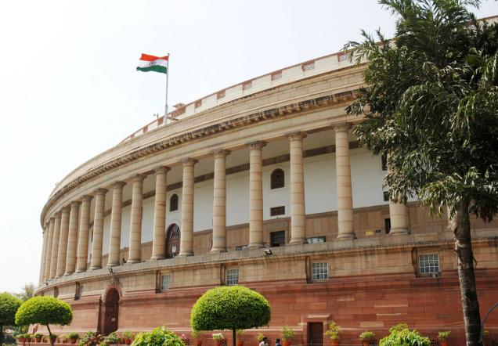
Polity: How does GST rollout work in real life?
Unlike VAT, all have to pass at once, else IGST “credit” won’t work
Central (CGST)
UT without Legislature
State (SGST)
122nd bill |
101st Amendment Act
UTGST Law [on without Legislature]
GST Council (279-A)
IGST Law
Max40%
CGST Law
Max20%
Parliament Bill
Vidhan Sabha
SGST Law
Max20%
GST
Compen-sation
Law
Simple majority; money bill! Don’t need special majority & 50% state consent every time.
Only on their recommendation!!
Notes:
नही तो हरबार Constitutional amendment करने गये तो साला कोई काम टाइम पे हो ही नही सकता.

Slide 37
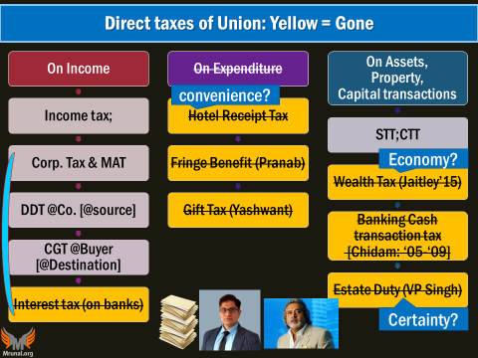
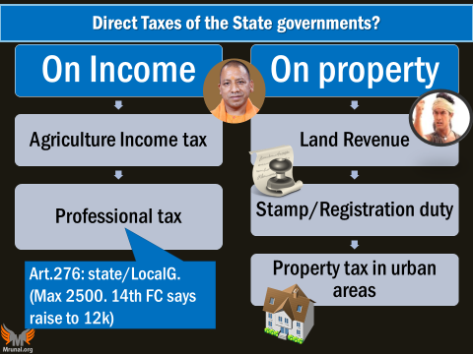
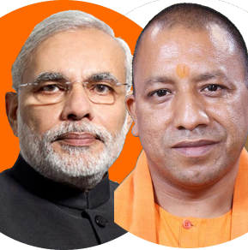
GST will not subsume “DIRECT TAXES” of Union and States
मित्रों, GST is an indirect tax on consumption!

Slide 38




Indirect Taxes -> Union
Union
Custom Duty
Excise Duty
Service Tax
CST [00]
Basic
Additional
Petroleum
-”DESHI”, Narcotics
Others
Tobacco
CVD
Sp. Additional
[+Alcohol,
Med.TP]
+ Cess
Surcharge on these things
To counter balance foreign products vs. deshi products (VAT, excise…)
When GST council decides (5)
crude, high speed diesel, petrol, ATF and natural gas
GST + this also.
Red matlab REMOVED UNDER GST
Notes:
Since the States are not empowered to levy any tax on the sale or purchase of goods in the course of their
importation into or exportation from India, the Centre levies and collects this tax as additional duties of customs, which is in addition to the Basic Customs Duty. This additional duty of customs (commonly known as CVD and SAD) counter balances excise duties, sales tax, State VAT and other taxes levied on the like domestic product.

Slide 39

Indirect Taxes -> STATE
State
Selling= VAT
Excise on Liquor, Narcotics
PURCHASE Tax
Entertainment
-NOT medicinal, toiletry prep.
UNION
-NOT TV, Radio, Newspaper
UNION
Advertisement
Petroleum
Vehicle, Animal, boats
Luxury
Tolls, Transport, Entry Tax /Octroi
Betting-gambling
IF taken by Local Bodies
IF taken by Local Bodies
-NOT Newspaper
UNION
Electricity (?)
Transmission, Distribution, Sale
Road Tax (?)
When GST council decides
“DESHI”
+ Cess
Surcharge on these things
Red matlab REMOVED UNDER GST
Notes:
http://energy.economictimes.indiatimes.com/news/power/electricity-should-be-included-in-gst-regime-ieema/56447141

Slide 40



Taxes: GST will subsume everything EXCEPT Direct Tax+ what Devgan touches
Bike import Custom Duty
Crude oil-import (Custom)
GST+ Central Excise
Petrol: Excise-VAT
STATE EXCISE
local bodies assigned + electricity duty (?)+ road tax(?)
When its clarified, you edit this slide.

Slide 41
Goods and services Tax (GST)
Cascading Effect, ITC, MODVAT, CENVAT, VAT
Polity Angle, GST council?
Benefits
Compensation
Cess
Classification
& Slabs
Challenges:
E-way bill, “Compliance Cost”?
GST: IGST, CGST, SGST, UTGST
GSTIN Registration?

Slide 42





GST Benefits: “Generic”
Demand ▲
More production
Make In India-> Jobs, CAD, GDP
Prices ▼
Ordinary states: !Retailers 20 lakh|< [Can’t demand GST from people]
Inspector Raj ▼
GSTN portal
Less human interface
Compliance Cost ▼
Ease of Doing->FDI
Big malls: Cascading: 25-30% burden ▼ [hoarding, Cess]
Consumption + production + Jobs = Tax Base▲, Fiscal Deficit ▼
पन ये सब तो 'चालु' मुद्दे है! परीक्षा में मार्क्स खींचने है, तो कुछ Specific बताओ.
Notes:
Cascading burden: 25-30% down
Both goods and services
Standard rates
Min. exemptions
Biz Expand, Jobs, GDP, ▲
Tax base, collection

Slide 43



(in theory) Rate Arbitrage ▼= balanced regional growth ▲
VAT 14.5%
VAT 12.5%
1 crore ki LUXURY car
= Rs.2 lakh saved by MH purchase.
VAT: Destination based tax but rates not uniform
But sGST uniform

Slide 44


(in real life) Rate Arbitrage: may still continue
Union
Excise: 8-24%
Infra Cess 1-4%
States
VAT: 12.5-14.5%
Road Tax: 3-24%
SGST
CGST
Notes:
http://www.mycarhelpline.com/index.php?option=com_latestnews&view=detail&n_id=572&Itemid=10
http://auto.ndtv.com/news/road-tax-not-to-be-subsumed-under-gst-former-cbec-chairman-1683642

Slide 45




BEFORE: VAT/CST system: Warehousing (गोदाम) obsession
Warehouse in each state!
CST only on interstate “Commerce” not “transport”
Checkpost inspector raj [within state sale]
MSME can’t compete
CST
But credit only for CST
Excise
CGST+SGST
Even within state trade- still credits can be used
VAT
IGST
Notes:
CST = on Inter-state “Commerce” not “transport”. & CST credits can only be used for inter-state trade.
So, Companies maintain depots in all major states of India
MSME can’t compete price wise. CheckPost- harassment.
Central Sales Tax (CST) Act 1956
Std. rate: 2%, If bought for ‘resale/mfg’. [form “C”]
Otherwise higher rate (~4%)
CST origin based tax. Exporter state keeps money.
CST “input credits” can offset only CST liabilities

Slide 46


Excise-Vat structure, “Cascading effects”- companies tried ‘inhouse’ production
CGST
Excise duty
CST
VAT
SGST
GST Credit on input so….
Ancillarisation
Outsourcing
Division of Labour
Subcontracting
MSME + jobs
Direct + indirect
Tax base increased
CGST
Service Tax
(SBC+KKC)
CGST
SGST

Slide 47


GST: SAME Base computation
present
GST computation
Same “BASE”
=overall tax
On customer ▼
Rs.10,000
Rs.11,000
Rs.10,000
10% Excise
10% CGST
12% SGST
12% VAT
1,000
1,320
1,000
1,200
BEFORE
AFTER
Notes:
Final price is 9% less

Slide 48





Custom
IGST
“Processing” (Excise type)
State
Central
Domestic Sale
CGST
IGST (Inter state)
EXPORT
0% GST
SGST (within state)
Custom
Import will be considered interstate trade, so IGST
Input credit
input credit +++

Slide 49




Exports will be zero rated, but need INVOICE
Input Credit
Import & domestic sale
Import, process & EXPORT
Tax Paid on input
10,000 (GST)
10,000 (GST)
Tax Received on Output
4000 [GST]
00 [Export 0%]
+6000
+10000 remain
Before: Cess, surcharge, excise-CST cascading effect etc.
After: gone = cheaper prices in international market. Export ▲
Notes:
Export “ZERO rated”
Exporter gets credit for the GST paid on inputs
BUT have to sell with bill, else no credit=> tax evasion prevented

Slide 50
Specific BENEFITs of GST: for mains, essay & interview
“Chaalu” nhi, give specific points, how GST will help!
Logistics
Ancillarisation
Same Base
Zero Rated Exports
Rate Arbitrage

Slide 51
Goods and services Tax (GST)
Cascading Effect, ITC, MODVAT, CENVAT, VAT
Polity Angle, GST council?
Benefits
Compensation
Cess
Classification
& Slabs
Challenges:
E-way bill, “Compliance Cost”?
GST: IGST, CGST, SGST, UTGST
GSTIN Registration?

Slide 52

GST: Benefit, now “Short term” Challenges (NOT negative points)
Even USA doesn’t have GST despite being federal country
GST is bad for the country
It’ll ruin small business
It’ll bring inflation
RBI “only short term”

Slide 53
If you want to copy USA taxation system, then copy it entirely!
Gross income
6 lakh
MINUS
Taxable
1.5 lakh (LIC, PPF etc)
3.5 lakh
1 lakh Agri. Income. States don’t tax.
2.5 lakh= 0%
1st slab: 5%
US states have
USA: Exemptions deductions Very less
USA flat 10%
USA federal slabs
10%
15%
..39.5%
+ State & local income taxes separately.
Notes:
$1= 17 Rs. 15%
25%
28%
33%
35%
39.6%

Slide 54


Challenges: Revenue Neutral Rate (RNR)?
Tax
Union Excise on cars
BEFORE
8%-24% +infra. Cess
Union Service Tax
14% + 0.5% KKC + 0.5% SBC
After
CGST?
CGST?
Depending on engine
How much it should be so that there is no deficit?
Same Q for states?
Notes:
Revenue neutral rate
If Union abolishes service, excise and various cess surcharges=> revenue income ▼
So whatever CGST is planned- its rate should be ▲ enough to sustain same money flow according to GDP
Same for State taxes=> SGST

Slide 55



Complex rates, settlement system
5
28
12
18
IGST: Ceiling 40%
CGST: 20%
SGST: 20%
Cascading effect continues: Petroleum products kept outside until GST council notifies date. =Excise, CST and VAT applicable. ▼ Crude oil = ▲ Excise raised to increase revenue collection.

Slide 56

GST: Destination based tax- industrialized states: unhappy
CGST
IGST
SGST credits transferred to
Destination (importer state)
In CST- could keep
But GST “Exporter”
State Gets Nothing ☹

Slide 57







Union: max. revenue from direct taxes
Descending order
NA
KEPT OUT
Outside GST
But for states, highest comes from VAT. But that’ll be abolished!!
So @ mercy of FC
for compensation
Notes:
Union: Highest collection from corporate (Direct tax)….outside GST
States: highest collection from VAT….gone under GST
Many state taxes, cess, surcharge gone
Revenue loss to states.
States will be at mercy of FC, to get share from union taxes ☹
+ Destination based tax not good for industrialized states

Slide 58

Reduce compensation over the years
Tapering
122nd Amendment bill provides for compensation for five years.
14th FC: Autonomous “GST compensation fund” through law with “tapering effect”

Slide 59



Base year: 2015-16: VAT, other indirect taxes
(absorbed in GST)
@end of 5yr (remaining amt)
50% to states proportion of their revenue
50% in Union’s divisible pool of taxes [FC]
GST Compensation Fund
Pay Each two months (Annual-CAG )
5%
12%
18%
28%
Most products in 12-18% slab
X 15% CESS = 13-20% real tax!
= INFLATION

Slide 60


GST state compensation Cess (May 2017)
Tobbacco, Cigar, Pan Masala
Aerated Softdrinks
Coal lignite Peat
Motor Vehicles
Air Craft, Yacht
Full list on http://www.thehindubusinessline.com/multimedia/archive/03166/GST-compensation-c_3166108a.pdf

Slide 61
Goods and services Tax (GST)
Cascading Effect, ITC, MODVAT, CENVAT, VAT
Polity Angle, GST council?
Benefits
Compensation
Cess
Classification
& Slabs
Challenges:
E-way bill, “Compliance Cost”?
GST: IGST, CGST, SGST, UTGST
GSTIN Registration?

Slide 62

GST Slabs and Classification notified on May 2017
Goods
fresh meat, fish chicken, eggs, milk, butter milk, curd, natural honey, fresh fruits and vegetables, flour, besan, bread, prasad, salt,
Services
Hotels and lodges with tariff below Rs 1,000
Grandfathering i.e. whatever was in "Exempt" or "Negative List" in Service tax, here also continues.
stamps, judicial papers,
Sindoor, bindi, bangles, handloom, etc.
printed books, newspapers,
0%
5%
12%
18%
28%
Lecture Link: Click me
Notes:
http://economictimes.indiatimes.com/news/economy/policy/a-quick-guide-to-india-gst-rates-in-2017/articleshow/58743715.cms

Slide 63







“Grandfathering”= services in negative / exempt list= !(service tax) same way !GST.
Services by govt, local bodies* <caveats, but we are not preparing for CA exam>
RBI, SEBI, PFRDA, EPFO, foreign Mission, UN etc.
Insurance & skilling schemes for poor
Electricity, News, Transmission*
Renting house for residence
Agri, Edu *, Healthcare, Sports
Total 83 Services. Full LIST available on http://www.thehindu.com/business/Economy/article18514302.ece/BINARY/Schedule%20of%20GST%20rates%20for%20services

Slide 64
GST Slabs and Classification notified on May 2017
Goods
fish fillet, cream, skimmed milk powder, branded paneer, frozen vegetables, coffee, tea, spices, pizza bread, rusk, sabudana,
Services
Transport services (Railways, air transport) because already petroleum excise, VAT
Coal <+compensation cess also)
medicines, stent, lifeboats
kerosene
Small restaurants
0%
5%
12%
18%
28%
Notes:
http://economictimes.indiatimes.com/news/economy/policy/a-quick-guide-to-india-gst-rates-in-2017/articleshow/58743715.cms

Slide 65
GST Slabs and Classification notified on May 2017
Goods
Frozen meat products,
Services
Non-AC hotels,
business class air ticket. <luxury..>
Work Contracts
butter, cheese, ghee, dry fruits in packaged form, animal fat, sausage, fruit juices, Bhutia, namkeen,
Ayurvedic medicines (!), tooth powder, agarbatti, colouring books, picture books, umbrella, sewing machine, cellphones
Fertilizers
0%
5%
12%
18%
28%
Notes:
http://economictimes.indiatimes.com/news/economy/policy/a-quick-guide-to-india-gst-rates-in-2017/articleshow/58743715.cms

Slide 66
GST Slabs and Classification notified on May 2017
Goods [most items here ☹]
Services
flavoured refined sugar, pasta, cornflakes, pastries and cakes, preserved vegetables, jams, sauces, soups, instant food mixes
AC hotels that serve liquor.
IT services, telecom services ☹
branded garments and
financial services ☹ [poor-walli “grand-fathered” 0%]
ice cream ☹, mineral water, tissues, envelopes, tampons, note books, steel products,
printed circuits, camera, speakers and monitors ☹
0%
5%
12%
18%
28%
Notes:
http://economictimes.indiatimes.com/news/economy/policy/a-quick-guide-to-india-gst-rates-in-2017/articleshow/58743715.cms

Slide 67

GST Slabs and Classification notified on May 2017
Goods
Services
Chewing gum, wafers coated with chocolate (Baba Ramdev!)
Aerated water, paint, deodorants, shaving creams, shampoo, dye, sunscreen,
automobiles, motorcycles, aircraft for personal use <+ GST compensation CESS ALSO>
5-star hotels,
Cinema (= will improve board exam result ☺ & discourage production of high-budget fatichar movies. Except when “Loss” is method for turning black money to white.)
race club betting,
weighing/ vending machine, ATM
pan masala pe GST, TOBACCO <Excise also>; +GST compensation Cess.
wallpaper, ceramic tiles, water heater, dishwasher, vacuum cleaner, washing machine.
0%
5%
12%
18%
28%
Full list on
www.thehindubusinessline.com/multimedia/archive/03166/GST_rate_schedule__3166109a.pdf
Notes:
http://economictimes.indiatimes.com/news/economy/policy/a-quick-guide-to-india-gst-rates-in-2017/articleshow/58743715.cms

Slide 68

May 2017: GST council Srinagar Meeting- couldn’t decide following..
Bidi
Footwear
Gold, gems, jewelry
Agri machinery
Textile
Will decide on 3rd June 2017
When it comes update PPT, by your self ☺

Slide 69



5% GST: raw hides
<paid on input>
5%*
28%
Compliance cost
Inspector-RAJ! Show records that you’re not selling cigar holders in invoice of chappal!
Classification Dispute & litigation
not cigar holder but Pen holder-”Merit good”(5%)

Slide 70

Classification Disputes ☹ = litigation
Advance Ruling Authority (ARA) @Union & State
Rs.5k online fees
Rs.10k (Appeal)
Ayurvedic Healthfood
Wafer coated Chocolate?
12%
28% “luxury”
Notes:
Globally, most regimes have a single rate. India has adopted a four-tier tax structure of 5%, 12%, 18% and 28%. The rate applicable on most products will be 18%
The highest rate has been pegged in the GST law at 40%. Many experts have said this structure will undermine the basic tenet of GST — a simple structure with at most two rates.
Pastries, sweet biscuits and cakes attract 6% excise duty, but for those containing chocolate or having a chocolate coating this is 12.5%. Packaged biscuits with a retail price not exceeding Rs 100 per kg are not levied any tax. While 6% excise is levied on leather footwear, other kinds attract 12.5%.

Slide 71
Goods and services Tax (GST)
Cascading Effect, ITC, MODVAT, CENVAT, VAT
Polity Angle, GST council?
Benefits
Compensation
Cess
Classification
& Slabs
Challenges:
E-way bill, “Compliance Cost”?
GST: IGST, CGST, SGST, UTGST
GSTIN Registration?

Slide 72

GST “compliance” is expensive to MSME ☹ although DIY automated apps, portals being designed ☺
VAT returns each 3 months. I could do myself!
AC sold= VAT
AC service = !service tax (turnover <10 lakh) but here composite cap: >20 lakh turnover (ordinary state)
DBM, accounting ☹
GST: thrice each month!
(10, 15, 20th) = have to hire a full time accountant! या तो सेठजी मेरी पगार बढानी पड़ेगी!

Slide 73

MSME: Excise: turnover upto 1.5 cr. No need;
GST turnover
>10 lakh (sp. Cat. States as Art. 279-A)
>20 lakh (ordinary states)
Leather, handicraft
Inflation
Synthetic PU, MNC, Chinese

Slide 74



GST implementation: “e-Commerce”
To check on Evasion, data analytics-Wholesaler, Supplier’s PAN card
TCS: 2%
Payment to supplier
Market place model
but “30 days returns” are high (10-30%)
Notes:
cited the preparation time needed for small and medium-scale enterprises to get on to the new tax reform structure and the time needed for activating the GSTN platform
GST would improve tax collection and plug tax evasion loopholes but may lead to higher inflation in the immediate future,
Most companies are too small to afford a full-time accounts office,” Goel says. In the current system, VAT or excise returns have to be filed once in three months. Under GST, returns (sales, purchase) have to be filed thrice a month (on the 10th, 15th and 20th). "Working capital needs will increase. We might have to hire a full-time accountant,"
"Returns in e-commerce are high, ranging between 10% and 30%, taking up to two months," says Chopra, who is also a seller for e-commerce companies. "Once GST is paid and when buyers returns goods, how will GST reversal happen?" asks Chopra.

Slide 75

E-way bill for all transit >Rs. 50k.[be in inter/ intra state]
Multiple cargo, Truck replacement during breakdown
Compliance cost☹ [even for non GST items] e.g. fresh vegetables ☹
Hv2 generate new bill! Validity 15 days. Disaster..?
Register
Download, Printout
Inspection
Notes:
E-way/ Transit bill
For intra and interstate transport- if consignment > 50k. Max. validity 15 days (for 1000 kms)
Even for goods outside its ambit e.g. agriculture
Even if multiple sellers sending in same truck.
What if delay, vehicle change? If new bill now created then confiscate / no input credit.

Slide 76
Goods and services Tax (GST)
Cascading Effect, ITC, MODVAT, CENVAT, VAT
Polity Angle, GST council?
Benefits
Compensation
Cess
Classification
& Slabs
Challenges:
E-way bill, “Compliance Cost”?
GST: IGST, CGST, SGST, UTGST
GSTIN Registration?

Slide 77
Who has to get what?
Every tax payer, share market investor: individual, corporate, firm
PAN
Income tax
NPS
PRAN
From PFRDA
Every one
Aadhar
UID
EPFO
UAN: unified account number
LIN: Labour identification number

Slide 78
Who has to get what?
Every entity deducting TAX (TDS)
TAN
Income Tax
VAT
TIN: Tax identification number
State VAT/ commercial tax Department
GST
GST-IN
GSTN (goods and services tax network) Private limited company

Slide 79
Yes, but who has to get this number? Final customer
Excise
Service
VAT
GST-IN
GST-IN
GST-IN
Goods |/Services “SUPPLY”: Annual turnover:
Special category states: Rs. 10 lakh > [hill states, NE]
Ordinary states: Rs. 20 lakh >
No input credit or compounding: Rs. 50 lakh < [flat rate]
+ exemptions, caveats to certain product categories.
Earlier EXCISE: upto 1.5 cr exempt (would not get input credit)

Slide 80


But where to get this GST-IN number?
Not for profit
Function
IT infra to union, States for GST
Section 8 (Companies Act ‘2013)
Section 25 (Companies Act 1956)
Authorized capital
Rs.10 cr. + Rs.315 cr Union grant
Private Ltd.
2-200
Special purpose Vehicle (SPV)
2013, Chidambaram

Slide 81

Functions of GSTN SPV
Infosys develops the software

Slide 82

DATA privacy issue….BUT
Union Excise & Service
Union Income Tax
Big data analytics on tax evaders
ACES (automation of central excise and service tax). By Wipro
Project Insight by L&T InfoTech

Slide 83

GST-IN number: 15 alpha-numeric
PAN CARD is prerequisite
“10 digit” alphanumeric code
CENSUS code
1-9, A-Z
Sankalp ltd.
Pizza
Punjabi
Spa
..max 35
Notes:
First two digits of 15 digits GSTIN represents State name of India. The next 10 digits is alphanumeric numbers of PAN number of person or firm engaged in Business.
In the GSTIN, the State Code as defined under the Indian Census 2011 would be adopted. In terms of the Indian Census 2011, each State has been allotted a unique two digit code e.g. 9? for the State of Uttar Pradesh and „27? for the State of Maharashtra.
13th digit would be alpha-numeric (1-9 and then A-Z) and would be assigned depending on the number of registrations a legal entity (having the same PAN) has within one State. For example, a legal entity with single registration within a State would have „1? as 13th digit of the GSTIN. If the same legal entity goes for a second registration for a second business vertical in the same State, the 13th digit of GSTIN assigned to this second entity would be „2?.This way 35 business verticals of the same legal entity can be registered within a State.
14th digit of GSTIN would be kept BLANK for future use.

Slide 84


Administrative control over “assesse” (IT)| “Supplier” GST
Turnover 1.5 Cr./>
Turnover <1.5 cr
50%
50%
10%
90%
Notes:
Territorial water- delegated

Slide 85
GST framework: Administrative & Personnel challanges
बच्चा यादव, ज्यादा Left-right करने की जरूरत नही. डिपार्टमेंट अकेला आप से नही चलता है.
हमारी नोकरी पे खतरा आया तो इंट से इंट बजा देंगे!
सर,डीजल फंड में भी पैसा नही, और हफ्तेभर बिजली और Broadband की बंध है!
States to get 100% compensation; Staff becomes slack, Tax Evasion↑ Tax base ↓
FRBM in letter but not “in spirit”
Personnel, Posting, promotion, seniority & assimilation of State VAT vs. CBEC
Data Migration, ICT connectivity with GSTN network
Rename: CBEC-> CBIT
Notes:
~1 lakh excise assesses
~8 lakh service tax assesses
GST: ~30 lakh assesses
Data Management issues.
Goods and Services Tax Network (GSTN) ltd to give ICT services.
Personnel and service related issues among state VAT vs. CBEC staff.
States to get 100% compensation: VAT-staff to become slack. Evasion ▲, Tax base ▼. FRBM ‘not in sprit’
Data migration to GSTN, IT infra.
Rename: CBEC-> CBIT
21 zones, 49 audit commissionerates, 50 appeal commissionerates, 768 divisions, 3969 ranges...

Slide 86


Inspector raj?
GST
Project SAKSHAM: for CBEC tax integration (GST+ custom), ease of doing, online interface
4 tier training program for all
Officers would have “restrictive” powers of inspection, search, seizure and arrest.
Anti-profiteering clause has been provided in order to ensure that business passes on the benefit of reduced tax incidence to the consumers
Notes:
Goods and Services Tax Appellate Tribunal would be constituted by the Central Government for hearing appeals against the orders passed by the Appellate Authority or the Revisional Authority. States would adopt the provisions relating to Tribunal in respective SGST Act
Advance Ruling Authority would be constituted by States in order to enable the taxpayer to seek a binding clarity on taxation matters from the department. Centre would adopt such authority under CGST Act.
Draft advance ruling norms provide that an application for advance ruling or appeal has to be filed online, with fees of Rs 5,000 or Rs 10,000, respectively.
Rs 1 crore to each of 23 CBEC zones to conduct an outreach programme about the new tax regime.

Slide 87
GST Challenges (not negative points) baaki long term benefits
Compensation
Classification
Compliance
Ecomm: TCS
E-way Bill
Administrative Challenges
MSME
Advance ruling

Slide 88



GST Introduction: Define
(Define) GST is a….
Destination based [excise, CST “origin”]
Indirect tax
on consumption.
GST applies on “SUPPLY” of….
Excise = Mfg
VAT = Sale

Slide 89
Conclusion: summary / finding..x +ve NOTE.
In a federal country with a 2 trillion dollar economy, indeed there will be challenges during the initial rollout of GST.
But, by absorbing most of the indirect taxes and
eliminating their cascading effects,
it will create a national market for goods and services.
Doubtlessly, GST is a major milestone in the indirect tax reforms in India.
Realistic assessment
Not single uniform because 4 rates & exemptions
MODVAT, CENVAT…

Slide 90



Constitution: one Territorial India..☺
Freedom of trade and commerce..☺
One economic India: 1 registration, 1 Tax, 1 Rate, 1 Form… ☹??
Current tax distortion: CST – warehousing, VAT - arbitrage
Hopefully, GST will fix all this.
<MORE under “TRADE” in BES17 ”4”>

Slide 91
Mock Question for Prelims
Which of the following are "source based" indirect taxes?
Excise
Central Sales Tax
Value Added Tax
Answer choices
Only 1 and 2
Only 2 and 3
Only 1 and 3
None of them

Slide 92
Mock Question for Prelims
Who among the following is/are the "permanent invitee(s)" to the GST council meetings?
Vice Chairman of NITI Ayog
Comptroller and Auditor General of India (CAG)
Controller General of Accounts (CGA)
Chairman of CBEC
Answer choices
Only 1
Only 2 and 3
Only 3 and 4
Only 4

Slide 93
Mock Question for Prelims
GST will subsume which of the following taxes?
Tax levied on sale and purchase of securities
Tax levied on sale and purchase of commodities through commodity exchange trade.
Basic custom duty on imports
Basic custom duty on exports
Answer choices
Only 1 and 2
All except 3
Only 1, 2 and 4
None of the them.

Slide 94
Mock Question for Prelims
UTGST is applicable on __?
Mfg. of goods and services in the union territories without legislature.
Sale of goods and services from union territories without legislature to rest of India.
Sale of goods and services in the union territories without legislature.
Only "B" and "C".

Slide 95
Mock Question for Prelims
Which of the following creates an opportunity for "Rate Arbitrage"?
Bread has 0% GST but Pizza-bread has 5% GST.
State-A levies 12.5% VAT on cars while State-B levies 14.5% VAT on cars.
Restaurant-A levies 5% service charge on the bill, while Restaurant-B levies 10% service charge on the bill.
All of the above.

Slide 96
Goods and services Tax (GST)
Cascading Effect, ITC, MODVAT, CENVAT, VAT
Polity Angle, GST council?
Benefits
Compensation
Cess
Classification
& Slabs
Challenges:
E-way bill, “Compliance Cost”?
GST: IGST, CGST, SGST, UTGST
GSTIN Registration?
+ Rates from TheHindu on 20th May.
Then new updates- self edit, PPT on Mrunal.org/powerpoint

Slide 97
Budget ► Revenue ► Receipt ► Tax
UBI
Goods and Services TAX
Fiscal Deficit
FRBM Panel Report
Black money, Demonetization

